Slide 1

Evaluation of 5G Open RAN simulation environments
Research Project
Professor: Dr.-Ing. Andreas Grebe
Student: Md Nur Mohammad
Student ID: 11145131
Master in Communication Systems and Networks

Slide 2
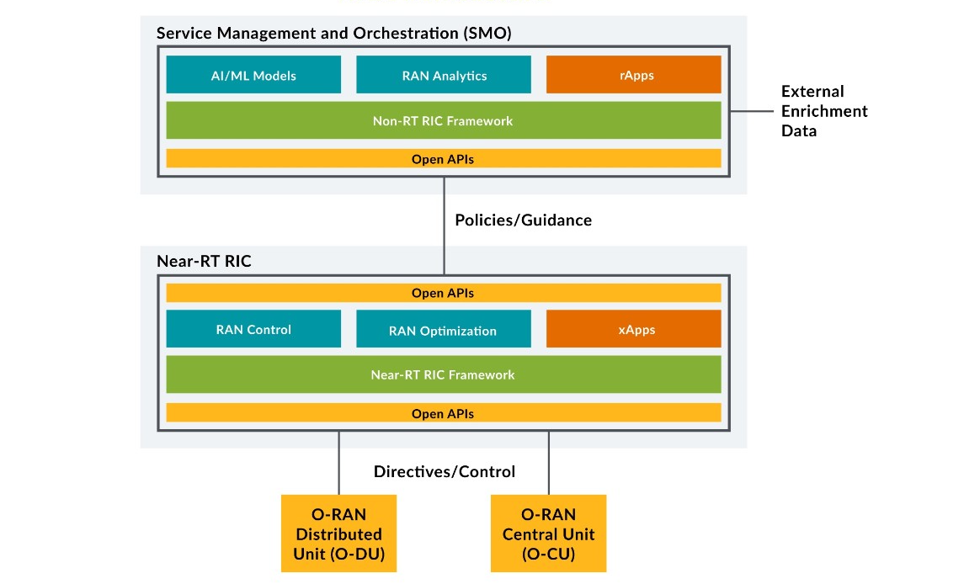

Slide 3
Last Meeting Details
Meeting (05.04.2023)
Go through the A1 interface in detail.
Find the way to test near-RT RIC and non-RT RIC.
Follow the O-RAN Alliance’s specifications for the A1 interface.

Slide 4
Last two weeks work
Followed O-RAN specifications for the A1 interface.
Focused on policy management service between near-RT RIC and non-RT RIC
Finding an open-source platform for testing both of them.
ONAP (Open Network Automation Platform) is introduced.

Slide 5
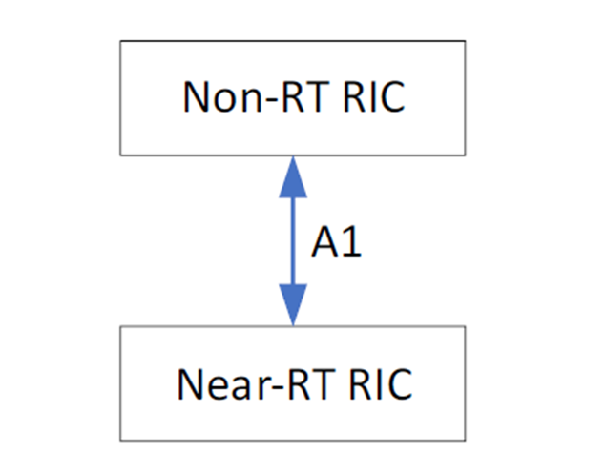
The O-RAN architecture description includes Non-RT RICs and Near-RT RICs connected by the A1 interface as shown in the figure

Slide 6
Role of A1 in the O-RAN architecture
Handles the distribution, configuration, and collection of data from the RAN nodes.
Support the AI/ML workflow.
Optimize the performance.
Allow the non-RT RIC to provide rule-based guidance, ML model management, and information to enhance the near-RT RIC.

Slide 7
A1 policy management service
Purpose of A1 policies is to guide the RAN's performance toward the overall goal expressed in the RAN's purpose.
Non-RT RIC can manage A1 policies based on the A1 policy response and the network state provided on O1.
RIC Near-RT is working based on its internal functions or applications, configuration received on O1 and transient policies received on A1.

Slide 8
A1 enrichment information service
To improve the performance of that entity's tasks.
O-RAN external source of information.
SMO can collect information from information sources inside O-RAN and outside of O-RAN.

Slide 9
A1 interface general principles
Open logical interface in the O-RAN architecture between the Non-RT-RIC functionality and the Near-RT-RIC.
Vendor independent and independent of specific implementations of SMO, Non-RT RIC and Near-RT RIC.
Enables policy-based targeting of internal radio resource management functions.
Provide basic feedback mechanism with near RT-RIC.
Enables the transmission of A1 enhancement information from the non-RT RIC to the near-end RT RIC.
Allows Near-RT to detect available enrichment information for which safe delivery can be guaranteed and to request which enrichment information to provide.

Slide 10
A1 interface specification objectives
Connects non-RT RIC with near-RT RIC.
Provides policy (UE)
Provides basic policy status feedback.
Provides enrichment information.

Slide 11
A1 interface Capabilities
Policy management information transfer from Non-RT RIC to Near -RT RIC.
Policy response from RT-near RIC to non-RT RIC.
Detects and requests A1 enrichment information from Near-RT RIC to Non-RT RIC and provides A1 enrichment information from Non-RT RIC to Near-RT RIC.

Slide 12
The policy management function
Used by non-RT RICs to provision and manage A1 policies in RIC near RT.
Used to create, update, and delete A1 policies.
Used to query the presence, content, and enforcement status of policy.
Supported by A1 policy fallback from RIC Near-RT to non-RT RIC.

Slide 13
Open Network Automation Platform (ONAP)
Open-source project hosted by the Linux Foundation.
Provides a comprehensive platform.
Enables service for providers and developers.
Helps accelerate the growth of a vibrant ecosystem.

Slide 14
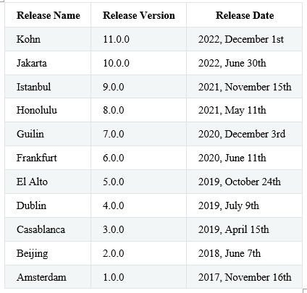
ONAP Releases

Slide 15
Features
Deeper O-RAN integration with A1 and O1 policy control for SON use cases
Improved flows for orchestrating and upgrading network functions Cloud Native (CNF) Networking with CCVPN Use Case.
Compute powerful KPIs for use in intent-based E2E network slicing.
Continued policy framework modernization, including messaging and Native Kafka Service Grid integration.
Security enhancements including removing known vulnerabilities and adopting critical software supply chain artifacts.

Slide 16
Kohn Release
Create Configuration for A1 Policy Management Service.
Configure the A1 Policy Management Service.
- Sample application configuration.
- JSON Schema for the application configuration.
Running the functions.
Run A1-enabled Controller.
Run OSC Near-RT-RIC/A1 Simulator Docker Containers
Run ONAP A1 Policy Management Service Docker Container.
- A1 Policy Management Service Swagger API.
Run OSC Non-RT RIC Control Panel Docker Container.
- Open NONRTRIC / A1 Policy Control Panel UI.

Slide 17
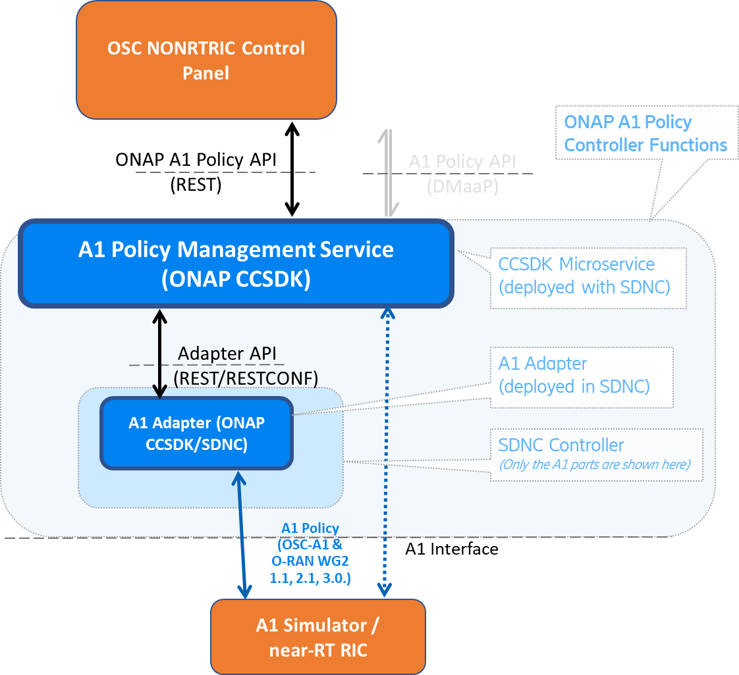
Architecture for Kohn Release

Slide 18
Project Requirements
Java 11 (make sure that JAVA_HOME environment variable points to correct Java version)
Maven 3.6 (make sure you have configured maven to access the ONAP maven repositories)
Docker and docker-compose (latest)

